Slide 1
ComfyUI – A visual Interface for Generative models
CART 498
By Malcolm Siné Tadonki
Maxim Yakimenko
Nicolas Hernandez

Slide 2
Setting up ComfyUI
Local Setup: Comfy Desktop
  Comfy Desktop, a local app that manages Comfy instances.
  Host generative models directly on your computer
    Models must be installed locally. Beware of the hardware requirements (processing power & storage)
  Works without an internet connection. Everything is in the local machine. But you can still access the cloud.
Cloud Setup: Comfy Cloud
  Work on your generative workflows seamlessly across multiple devices.
  Very easy to access. Can be opened on any browser and mobile device.
  Models are pre-installed. Use remote hardware for generative tasks.

Slide 3
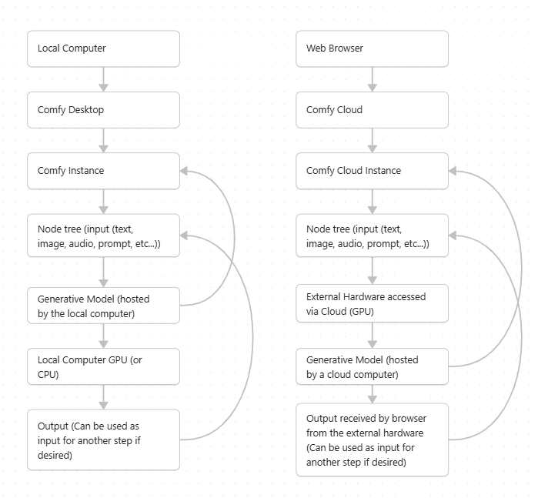
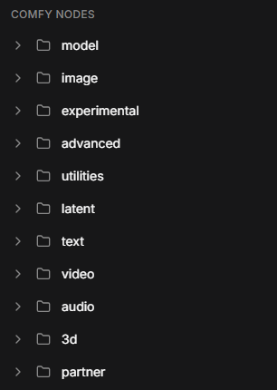
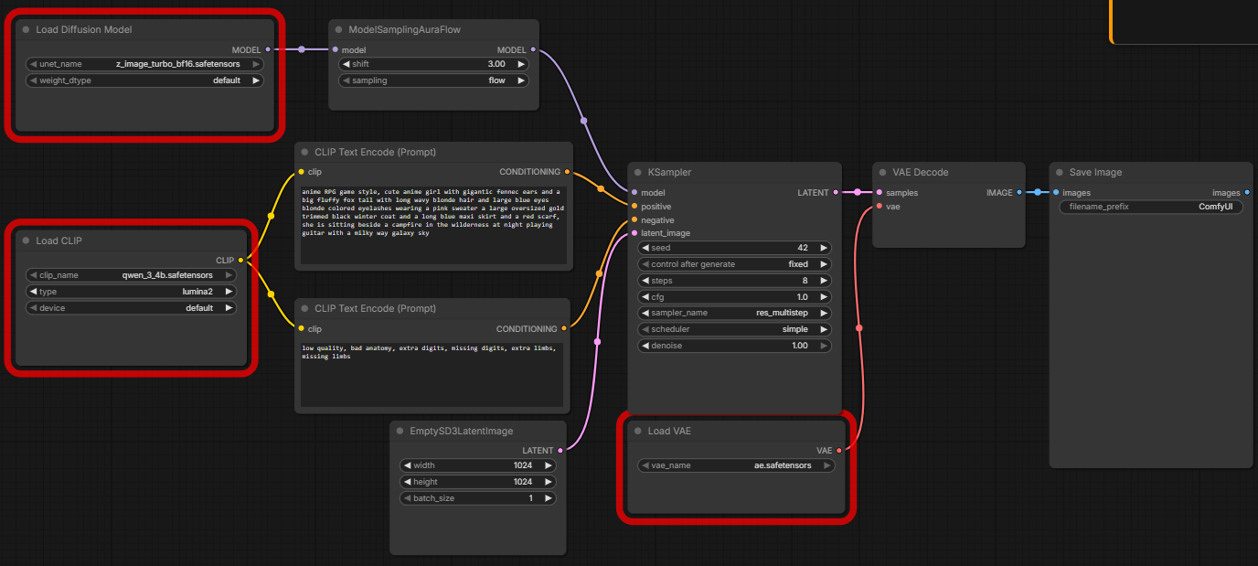
How does ComfyUI work?
ComfyUI, a visual coding like interface for managing generative models
  Models, input, output, and various other operations are nodes
  Chain multiple tasks together thanks to easy links between nodes

Slide 4
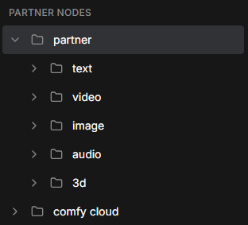
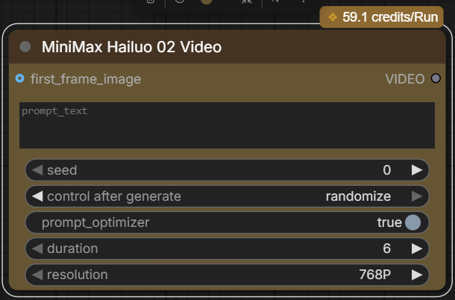
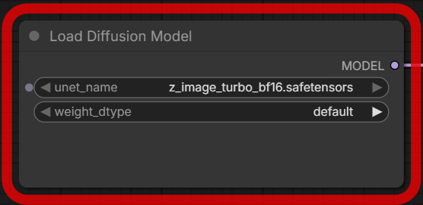
How does ComfyUI work?
Generative models and ComfyUI
  Generative models of many sources (HugginFace, CivitAI, etc…) can be used in ComfyUI
  Models are loaded through nodes or Partner Nodes
  Computation tasks are handled either by your machine (Comfy Desktop) or remote hardware (Comfy Cloud)
  Each generative model has its rules!
or

Slide 5
Interaction Paradigm
Basic Unit: Node
  Node-based interface
  Each node performs a specific operation within an AI workflow:
    Loading models, processing prompts, generating images or videos...
  Nodes are connected to create workflows
  Workflows define how data flows through the system
User Controls
  Workflow and node connection
  Text prompts and conditioning
  Generation parameters (seed, sampler, resolution, Classifier-Free Guidance
  Input / Output files
  Custom nodes and extensions

Slide 6
Human Agency
  Designs and modifies workflows
  Chooses models and settings
  Experiments with different configurations
  Evaluates and selects final outputs
Strengths
  Highly flexible and customizable
  Reusable workflows
  Transparent data flow
  Supports image, video, audio, and other AI workflows
  Precise control over steps and parameters
Weaknesses
  Steep learning curve for new users
  Complex node networks can be difficult to troubleshoot
  Requires technical understanding of node connections and dependencies
  Less intuitive than simpler, prompt-based interfaces
  Building workflows can be time-consuming

Slide 7
LIMITS & RISKS
Failure Cases:
Workflow configuration errors
  Missing or incompatible nodes
  GPU memory limitations
  Model incompatibilities
  Low-quality or unexpected outputs
  Outputs that do not match user intent
Bias and Output Limitations
Bias originates from underlying AI models and training data
Models may reproduce stereotypes
Some groups may be underrepresented
Generated outputs can contain inaccuracies or hallucinations

Slide 8
LIMITS & RISKS
Licensing:
Open-source (GPL 3.0)
Models, LoRAs, and other AI components may have their own licensing terms.
Some models impose restrictions on commercial use, redistribution, or other applications.
Users are responsible for checking the individual licenses and respecting their usage conditions
Privacy
Runs locally by default, keeping processing on the user's own device.
Prompts, input images, and generated files generally remain local when using local models and workflows.
Using cloud services, external APIs, or untrusted custom nodes can introduce privacy and security risks.

Slide 9
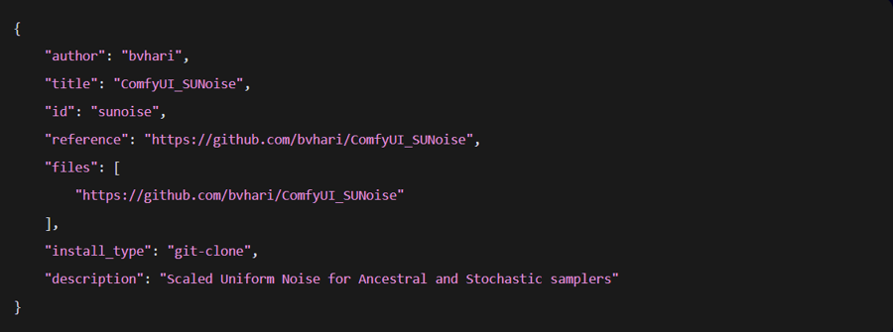
SECURITY RISK: CUSTOM NODES
Attack Vector:
Custom nodes can execute Python code, while frontend extensions can include JavaScript.
Malicious or vulnerable extensions can introduce security weaknesses, including cross-site scripting (XSS).
Attackers may exploit these weaknesses to interact with ComfyUI's backend API.
This can potentially allow unauthorized actions, such as installing malicious extensions or executing code on the system.

Slide 10
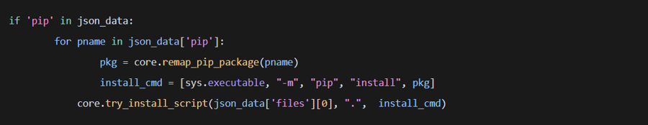
SECURITY RISK: CUSTOM NODES
Trusted Custom Node Entry
  How the Attack Works:
  Custom-node-list.json contains approved custom nodes.
  Each entry includes repository information and installation details.
  The files field identifies the approved repository..
  The vulnerability allowed attackers to manipulate additional installation parameters.
Dependency Installation Logic
  ComfyUI Manager processes dependency information during installation.
  Dependencies specified in the pip field can trigger automatic pip install commands.
  These commands install the Python packages required by a custom node.
  The pip field was not properly validated against the approved entry

Slide 11
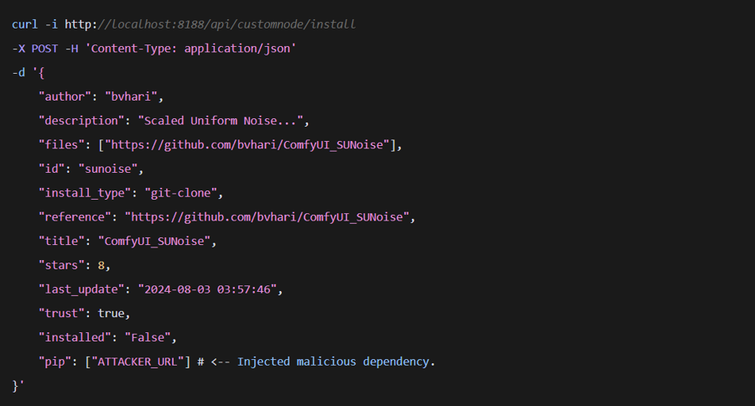
SECURITY RISK: CUSTOM NODES
Crafting the Exploit
  An attacker uses information from an existing approved custom node
  The installation request is modified by adding a malicious dependency to the pip field.
  The modified request is sent to ComfyUI Manager's installation API.
  The unvalidated dependency can potentially be installed.
Why it matters ?
  ComfyUI Manager executes pip install commands to install dependencies.
  Custom node entries were validated against an approved list.
  However, the pip field was not properly validated.
  This created a potential pathway for installing malicious packages and executing code on the system.
Consequences
  An attacker-controlled package is installed.
  Package installation can execute malicious code.
  Attackers may gain the ability to execute arbitrary commands on the system.
  This can result in Remote Code Execution (RCE).
  Update: Fixed in ComfyUI Manager v2.51.1. to a patched version addresses this specific vulnerability.

Slide 12
The potential of comfyUi for a final project

Slide 13
SOURCES
Snyk Labs
Onitza-Klugman, R., McNamara, R., & Ward, E. (2024, December 16). Don’t get too comfortable: Hacking ComfyUI through custom nodes. Snyk Labs.
https://labs.snyk.io/resources/hacking-comfyui-through-custom-nodes/
ComfyUI – Official Security Policy
Comfy-Org. (n.d.). Security policy. GitHub.
https://github.com/Comfy-Org/ComfyUI/blob/master/SECURITY.md
Doyensec
Sisco, S. (2025, March 27). ComfyUI Manager RCE via custom node install. Doyensec Security Advisory.
ComfyUI Official Website
  Comfy-Org. (n.d.).
  https://comfy.org/
ComfyUI Official Documentation
  Comfy-Org. (n.d.).
  https://docs.comfy.org/

